Slide 1
BTC Sentiment Analysis Can you successfully trade bitcoin based on sentiment ?
Joe Swiderski
Alex Waters
Ivan Tatum
SMU FinTech BootCamp 2020
Project 2

Slide 2
Motivations and Summary
Is it possible to take advantage of quantitative or qualitative data to exploit price movements in bitcoin?
Can we reliably predict Bitcoin Prices using a natural language processing algorithm?
We initially hypothesized that there would be some correlation between sentiment and the movement of bitcoin

Slide 3
Methodology
Layered Process
1.Is there a clear trading signal or trend ?
-Used the popular MACD (13/26) crossover signal
2. Sentiment Analyzers
-(New) Tweepy – download day’s worth of tweets
- Correlate Fear and Greed Index with BTC closing price.
- Twitter sentiment will be modeled using available data (7days)
- VADER, TextBlob, IBM Watson Sentiment Analyzers
3. Model Evaluation
- LSTM
- SARIMAX

Slide 4
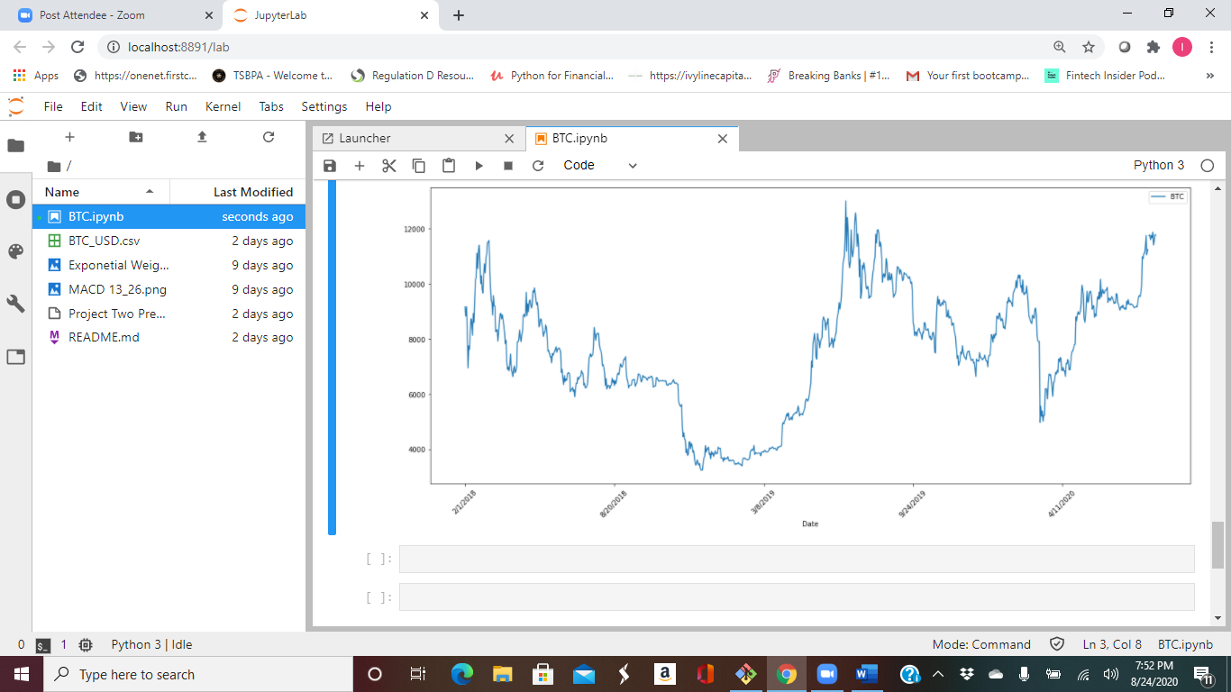
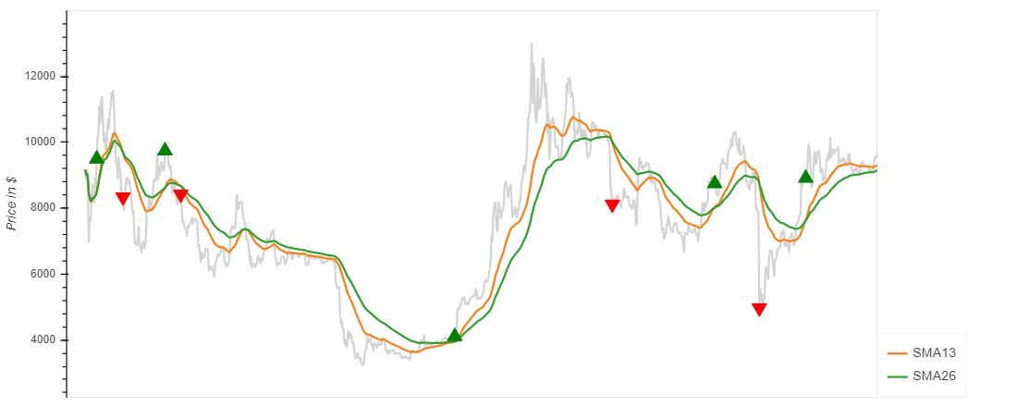
Was there anything to be gleaned from the technical trading signals? (Moving Average Convergence Divergence: 13 and 26 Days, 21/2018 - 8/14/2020)

Slide 5
Crossover Signal
No clear trends
Buying on the crossover signal only yields 4.5% cumulative return over time from Feb 2018 to August 2020.

Slide 6
Data Exploration
Hypothesized factors that could influence BTC prices.
* Past BTC prices
* Fear and Greed Index (sentiment)
* Stock Market Volume
* Removed dates prior to Feb 2018 because of the limited sentiment data obtained from the Twitter API.

Slide 7
Data Cleanup
* Truncate the dataset. Original data started from 2015, but the Twitter Sentiment Analysis begins in February of 2018
* Originally pulled tweets, but we used the fear and greed index as a proxy for sentiment.

Slide 8
Data Exploration (cont’d) Joe
Obtain tweets for ’Bitcoin’
Twitter developer account took 5 days to obtain
Twitter limits historical data to 7 days
Enterprise Historical PowerTrack is available at cost
Built downloader app that leverages tweepy library and wait_on_rate_limit feature. Downloading days worth of tweets averaged 5 hours
Process tweets from Twitter
Removed emojis, URLs, user names
Processed stop words, regex, lemmatizer
Sentiment Analyzer (FnG used as proxy)
VADER, TextBlob
IBM Watson Natural Language Understanding. Limited to 35k NLP requests per month. Twitter daily is north of this amount
Near Realtime Dashboard
Plotly Dash
Twitter rate limited to 900 status per 15 minutes
Retrieves 300 statuses every 5 minutes and processes sentiment
Combine fear/greed index figures with BTC price

Slide 9
Fear and Greed Index (first 10) (example)

Slide 10
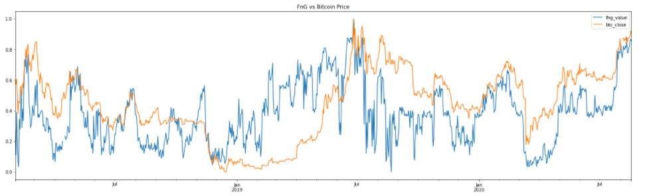
BTC closing price (red) vs Fear/Greed Index (blue)

Slide 11
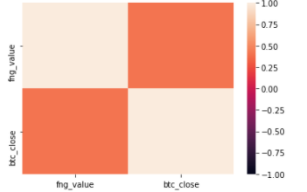
BTC price vs Fear/Greed Index Correlation (corr = .414)

Slide 12
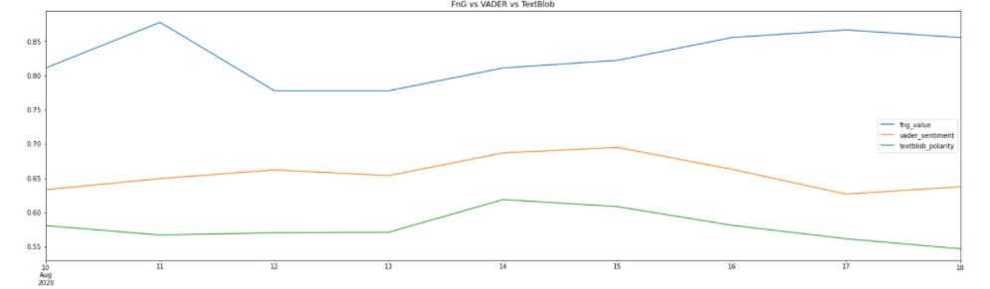
Comparison of Sentiment Analyzers

Slide 13
Model Evaluation Alex
* LSTM RNN (BTC Closing price)
* LSTM(fear/greed, SP 500)
* ARIMA (actual vs predicted bitcoin price)
* SARIMAX time series (BTC, BTC vol, SP 500, fear/greed

Slide 14
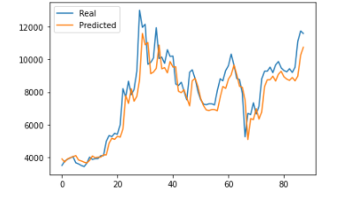
LSTM RNN (BTC close price)

Slide 15
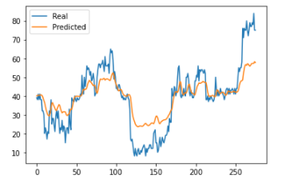
LSTM RNN (FNG)

Slide 16
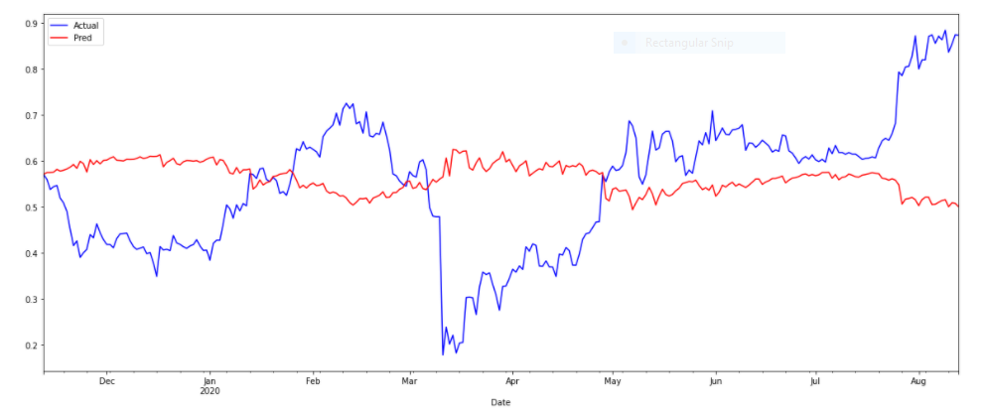
SARIMAX time series (BTC,BTC_vol,SP_500,FNG_Value)

Slide 17
Discussion
* Predictive Value of the Model
* Need to run more models on may more datasets. Need much more trial and error through repetition on other variables.

Slide 18
Questions and Issues
Finding more datasets to try and find predictive variables (ie. GDP, interest rates, bond prices, consumer sentiment,etc)
Possibly compare other cryptocurrency movements to see if they are correlated to one another.
Data is limited, so model prediction is undeveloped. More data points will be needed.
Greater adoption and clarity of use of cryptocurrencies may create greater ability to make predictions.

